Slide 1
Today we're going to talk about
-----------
Serving Machine Learning Models

Slide 2
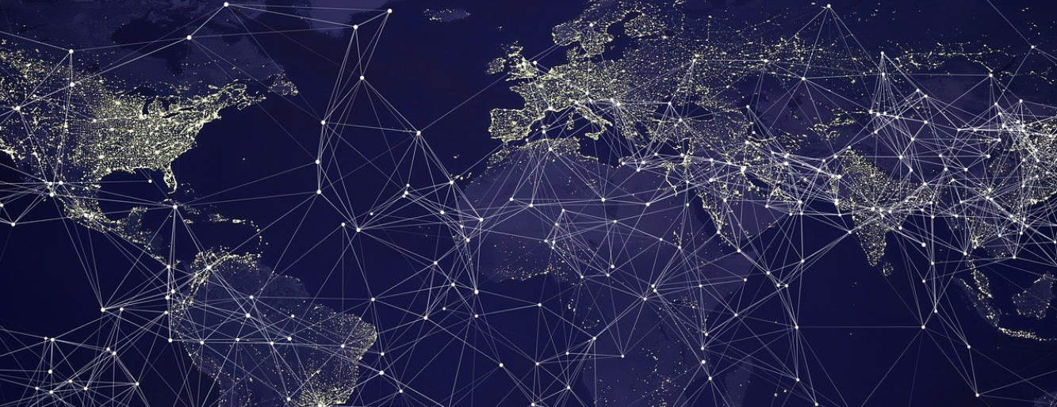
It all begins, with the internet.
What is … internet?

Slide 3
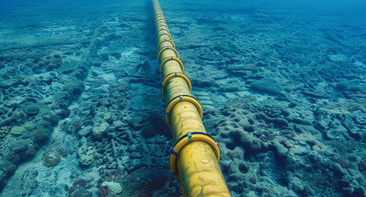
Underwater Cable

Slide 4
The cables go all the way from wherever up until it reaches es our houses. Specifically, it reaches 2 machines

Slide 5
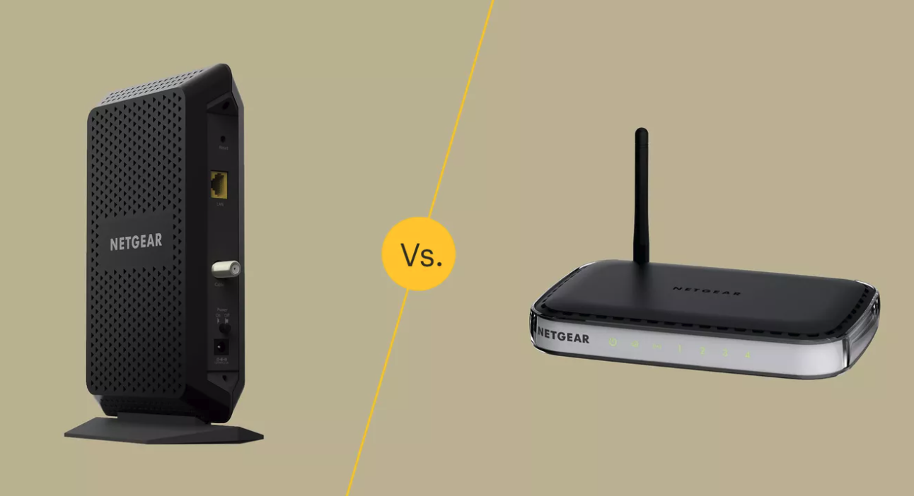
Modem – connects your home to the ISP. Translated analog signal (electricity) to digital signal
Router – Distributed the internet from the modem to all devices at home. Either through Ethernet or through WiFi

Slide 6
Okay, devices are connected to each other.
How is this useful?
When computers are connected, they can communicate. This communication, is what the internet is.

Slide 7
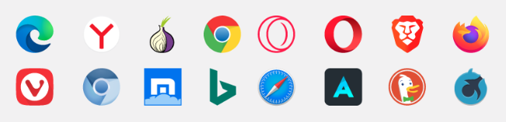
Browser
A nice-looking HTTP client

Slide 8
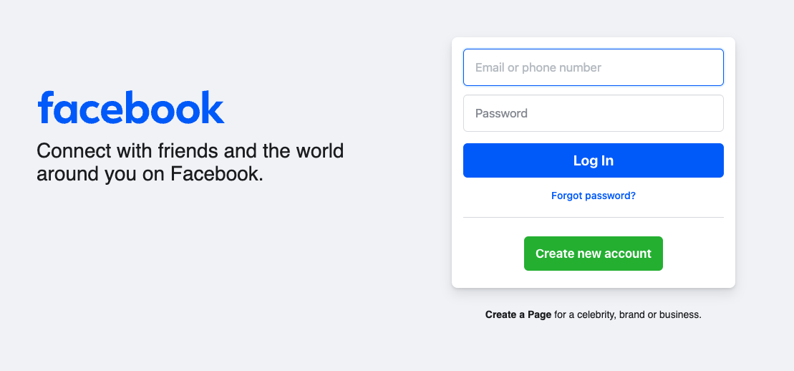
Browser Request

Slide 9
Communication Protocols
HTTP
WebSocket
gRPC

Slide 10
How does a request reach another computer?
DNS
IP – Public and private
PORT

Slide 11

Docker – The Most Important Whale
In the World
And... Kubernetes

